Slide 1
Выражение будущего
Present continuous
Future simple
прогнозы; обещания; решения, принятые в момент речи…
Present simple
действие по расписанию
ближайшее запланированноe
I’m playing tennis tomorrow.
I’m going to ask him.
I’ll show you how to handle the tool.
The train leaves tomorrow at 11 p.m.
I’m sure she will pass the exam.
I’ll do my best.

Slide 2
Выражение будущего

Slide 3
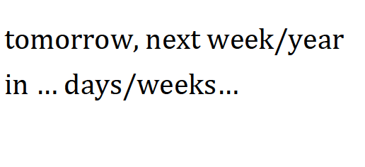
Future Simple
+: I / we/ you/he /she/it/they + will do
will = ‘ll
-: I / we/ you/he /she/it/they + will not do
will not = won’t [wount]
?: Will you do…?

Slide 4
Future Simple

